Slide 1
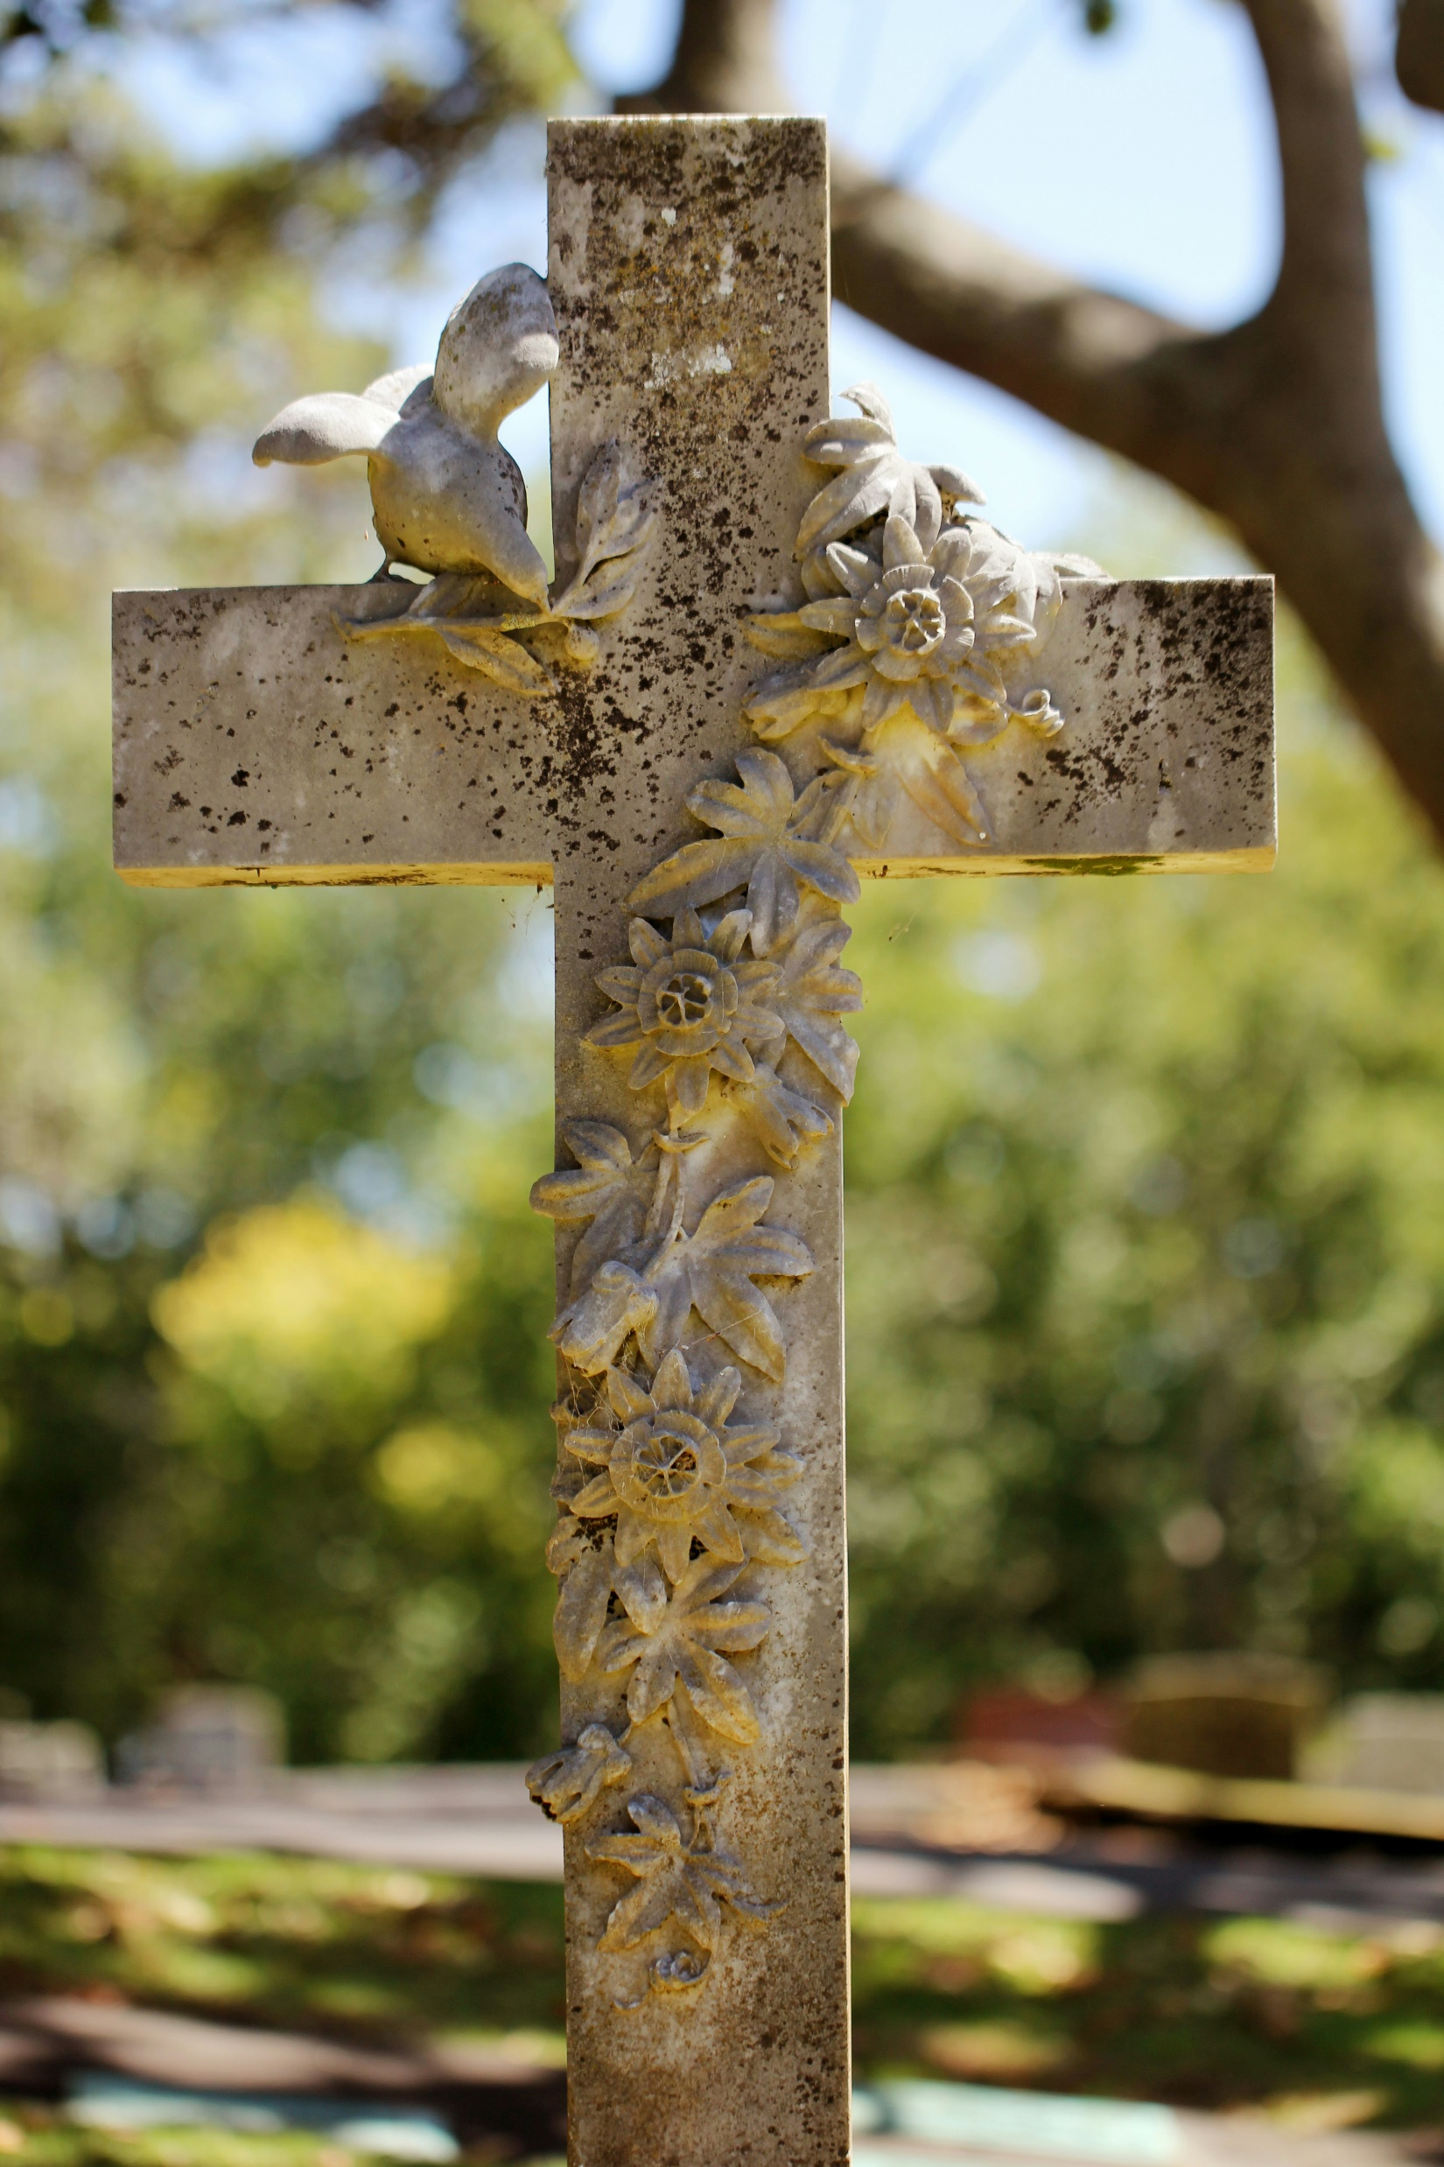

Holy Week 2024
Palm Sunday*, March 24, 8:30 & 10:00 am Holy Eucharist & Reading of the Passion
Rev. Carol Henley
Maundy Thursday, March 28, 6:00 pm
Potluck and Table Communion in Brooks Hall Stripping of the Altar
Rev. Carol Henley
Good Friday, March 29
12:00 noon, Silent Prayer
1:00 pm, Good Friday Liturgy with Music*
Dr. Michelle Domeisen
2:00 pm, Stations of the Cross*
Dr. Wesley Rohrer
Easter Vigil*, March 30, 8:00 pm
Holy Eucharist with Music
Rev. Carol Henley
Easter*, March 31, 10:00 am (combined)
Triumphant Choral Eucharist with Brass
Rev. Carol Henley
*Live-streamed

